Slide 1
Android Development Basics Crash Course

Slide 2
IDE

Slide 3
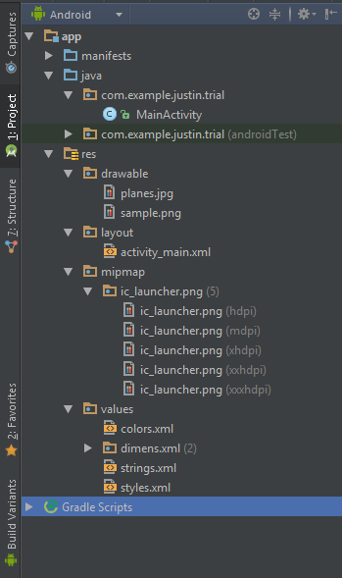
Contains Android Manifest that has essential info about the application
Java files
Assets
UI / XML Files
Assets that follows a certain format
Other auto generated files containing constant values

Slide 4
UI

Slide 5
Sample Code

Slide 6
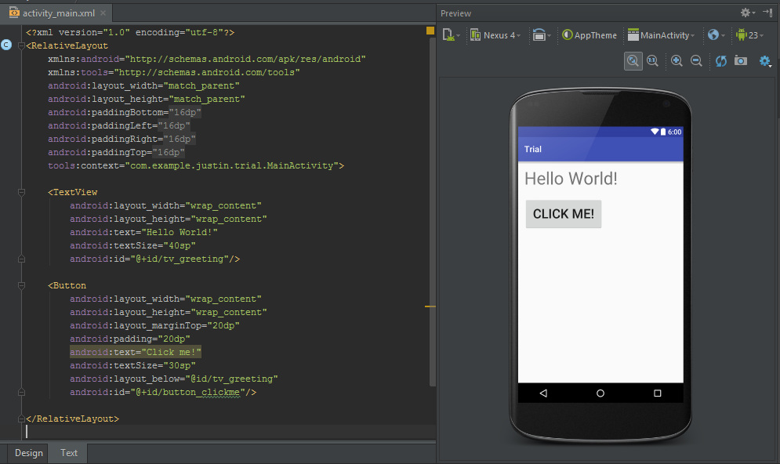

Slide 7
UI Element
UI Element attributes
UI Element attribute values

Slide 8
Commonly used UI Elements
TextView -> for displaying text
EditText -> used for asking input from user (text field)
ImageView -> used for displaying images
Button -> uhm clickable button

Slide 9
Required attributes for all UI elements
Some values used for those (width and height)
match_parent -> matches value of parent view
wrap_content -> matches the size of the value (or text) in the view
Specific size -> specify a random number, and unit of measurement is dp (e.g. 10dp)
android:layout_width
android:layout_height
e.g.

Slide 10
Other commonly used attributes of UI elements
android:text -> sets text
android:textSize -> sets text size
android:id -> to reference ui element in xml code or java code
android:hint -> placeholder (EditText) (aka hint text in text fields)
android:src -> (ImageView) set image location

Slide 11
android:id
@+id/<name>
-> declares new ID
@id/<name>
-> used to reference UI element in XML code
Declares TextView ID
References TextView element

Slide 12
Commonly used units of measurement
dp -> density-independent pixels -> used for sizes of widths, heights, margins, paddings, imagesize, etc.
sp -> scaleable pixels -> used for sizes of fonts

Slide 13
Java

Slide 14
Sample Code

Slide 15
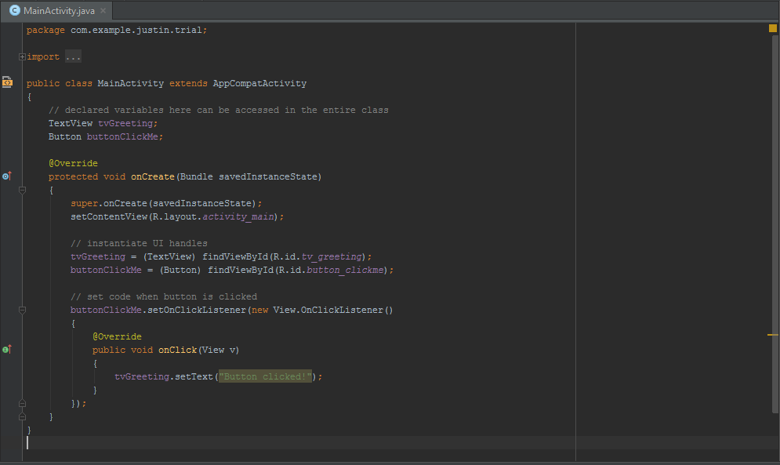

Slide 16
Common operations in Java code
Creating UI handles
Your main logic for your app

Slide 17
Creating UI handles
Declaration of UI handles
(can also be done inside methods, like onCreate()
Find the UI element with the id <idhere>
Main logic of sample program (change TextView from “Hello World!” to “Button clicked!” when button is clicked

Slide 18
FindViewById(int)
findViewByID takes R.id.<elementID> as parameter (which is the android:id of the UI element) in order to find the Ui element with that specific ID
This method returns a generic object that is why it needs to be typecasted into a TextView (in this example)

Slide 19
Button click event
Some UI elements like TextViews and Buttons can have EventListeners like setOnClickListener -> which does something when the view is clicked
to generate setOnClickListener code block:
<var>.setonclick
ctrl + space (to show code completion suggestions)
Find setOnClickListener and press Enter
type new then space
ctrl + space (to show code completion suggestions again)
Find onClickListener and press Enter
wait for code to generate
Place in the code (in this example, change TextView text)

